Slide 1

Fake News Detection Using Machine Learning
Presented By SAI KRISHNA VENI
(MCA Student, CUSAT)
Guided By Dr. Balasubramanian P
(Assistant Professor
Indian Institute of Information Technology Kottayam)

Slide 2
Outline:
FND Techniques
FND Stages
Text Preprocessing
Text Encoding
Classification
ML Algorithms used for Classification
KNN
Naive Bayes
Decision Tree
SVM
Random Forest
Confusion Matrix and Evaluation Matrix
Introduction to DL Algorithms
ANN
CNN
RNN

Slide 3
Introduction
-> Fake news is false or misleading information presented as it were real news.
-> False news is like an unproven story that spreads quickly that spreads quickly because people belive it’s true.
-> It can spread through social media, websites or even traditional news outlets.
-> It may be created to make money, to influence opinions, or to cause harm.
-> It is critical of the news we read and to check if it comes from a reliable source.

Slide 4
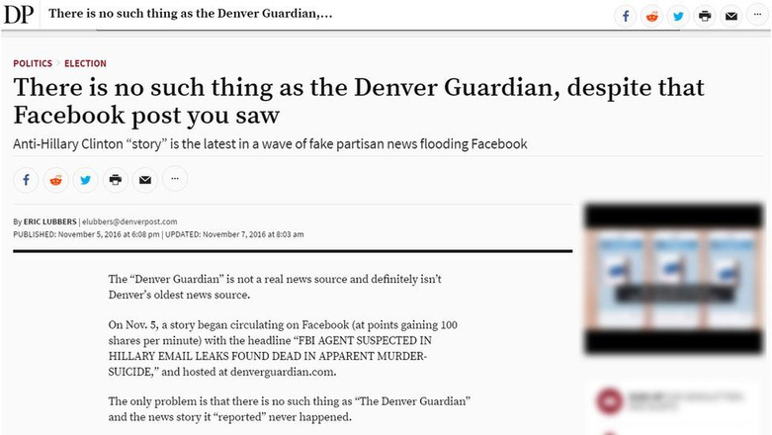
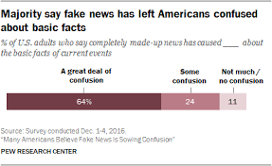
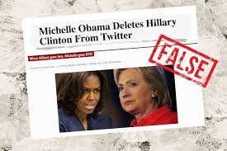
2016 US ELECTION - Fake News

Slide 5

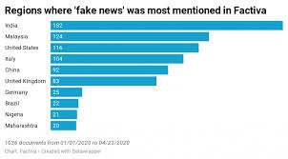
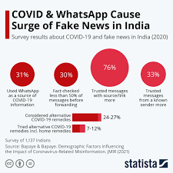

Covid-19 Fake News

Slide 6
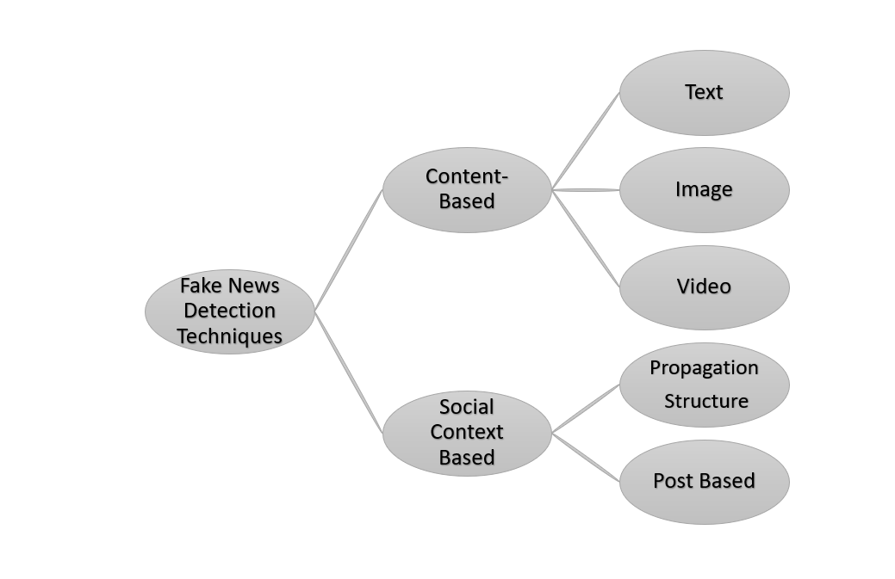

Slide 7


Fake News Detection Stages
Text Preprocessing
Text Encoding
Classification
Fake News Dataset

Slide 8
Text Preprocessing
Text preprocessing is a method to clean the text data and make it ready to feed data to the model. Text data contains noise in various forms like emotions, punctuation, text in a different case.

Slide 9
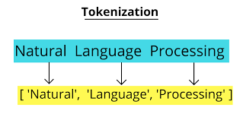
Tokenization:
Tokenization is a way of separating a piece of text into smaller units called tokens. Here, tokens can be either words, characters, or subwords.
2. Stop Word Removal:
Stopwords removal in natural language processing (NLP) is the process of eliminating words that occur frequently in a language but carry little or no meaning.
Original Sentence: The cat is in the hat.
Remove Stop Words: Remove "the," "is," and "in.”
After Stop Words Removal: cat hat.

Slide 10
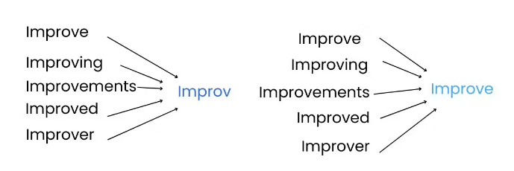
3.
Stemming:
Lemmatization:
Stemming is to reduce words to their root or base form.
Lemmatization is to break a word down to its root meaning to identify similarities.
Stemming
Lemmatization

Slide 11
Text Encoding
Text encoding is a process to convert meaningful text into number / vector representation so as to preserve the context and relationship between words and sentences, such that a machine can understand the pattern associated in any text and can make out the context of sentences.

Slide 12
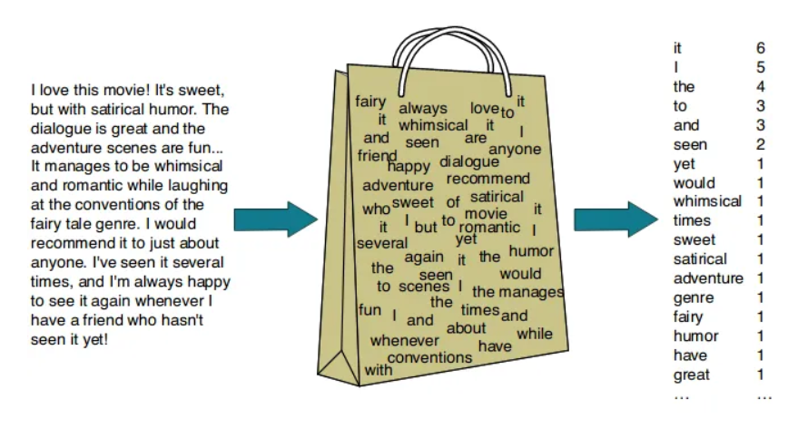
Bag Of Words (BOW):
A bag of words is a representation of text that describes the occurrence of words within a document.

Slide 13


2. TF - IDF:
Term Frequency-Inverse Document Frequency, is a statistical measure used to evaluate the importance of a word in a document relative to a collection of documents (corpus).
TF (Text Frequency):
The number of times a term (word) appears in a document.
IDF(Inverse Document Frequency)
A measure of how much information the word provides, i.e., whether the term is common or rare across all documents.
TF - IDF = TF * IDF

Slide 14
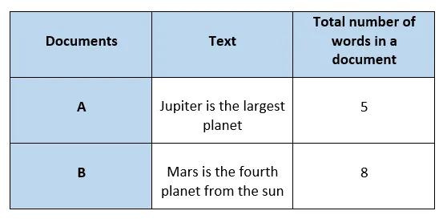
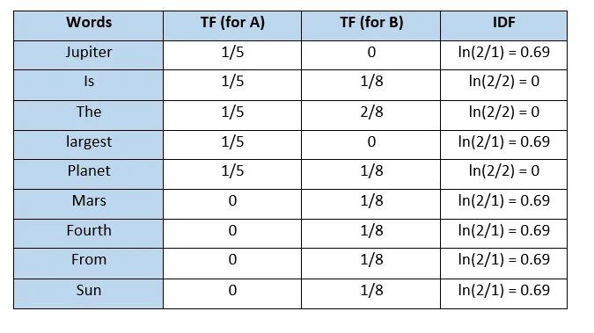
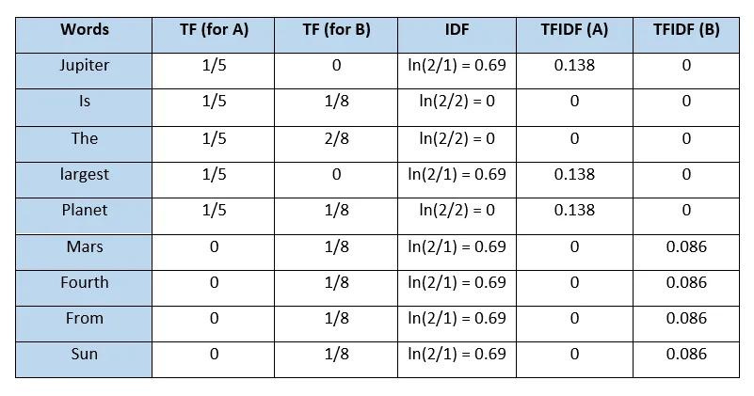
Example:

Slide 15
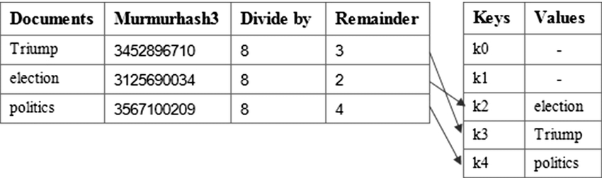
3. Hashing Vectorizer:
The Hashing Vectorizer uses a hashing function to map terms to indices in the feature space, making it both space-efficient and fast.
Commonly used Hash Function: hash(k)=k mod N
k: Represents a feature or term in a document. For text data, this could be a word, n-gram, or any other unit of text that you're using to represent the document.
N: Refers to the number of features or dimensions in the resulting vector space. This is often the size of the hash table used in the vectorization process.

Slide 16
4. Classification:
In classification, the model is fully trained using the training data, and then it is evaluated on test data before being used to perform prediction on new unseen data.
ML Algorithms
DL Algorithms
KNN
Naive Bayes
Decision Tree
SVM
Random Forest...
ANN
CNN
RNN

Slide 17
Machine Learning Classifiers

Slide 18
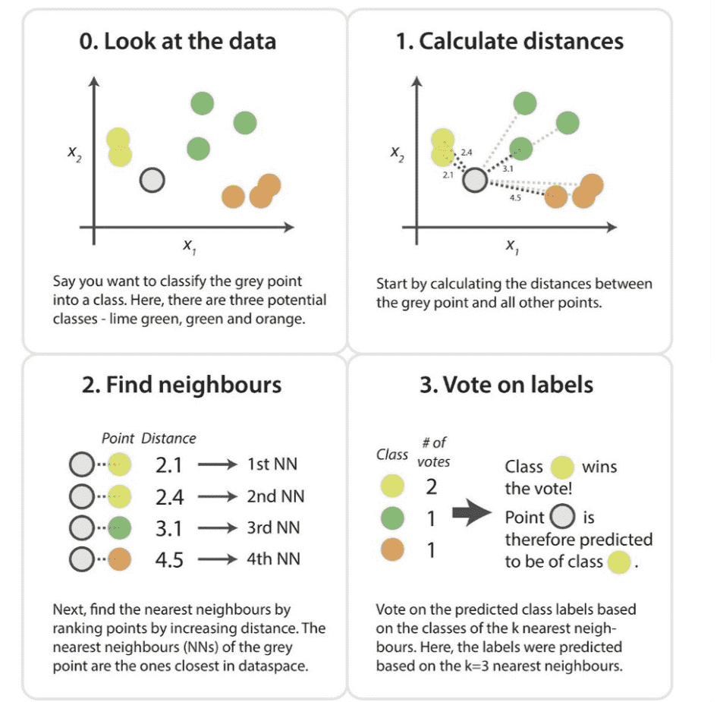


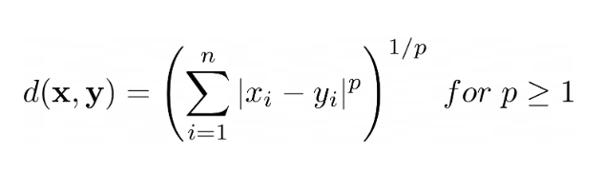
K Nearest Neighbors(KNN)
Supervised Learning algorithm.
Distance Formulas used in KNN:
·Euclidean Distance:
·Manhattan Distance:
·Minkowski Distance:

Slide 19
Naive Bayers Algorithm
Naive Bayes is a probabilistic classification algorithm based on Bayes' theorem with an assumption of independence among features.
P (Class |Data) = P (Class ∩ Data) / P(Data)
Usually, in the training data we would not be able to directly calculate the value of P (Class ∩ Data), so we can rewrite the formula as
P (Class |Data) = P (Data ∩ Class) * P (Class) / P(Data)
The P (Data) is used as a normalizing factor, thus we can ignore P(Data) for easy calculation as comparison between the probabilities are only considered.
P (Class |Data) = P (Data ∩ Class) * P (Class)

Slide 20
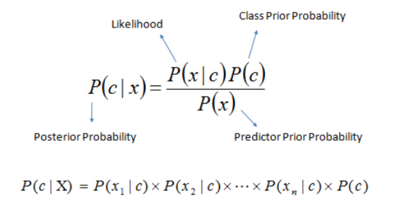
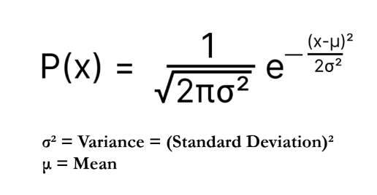
Multinomial Naive Bayes:
Effective for text classification problems such as document categorization and spam detection.
It assumes that the features represent the frequency or count of occurrences of events, typically words in a document.
Gaussian Naive Bayes:
Naive Bayes algorithm tailored for continuous data, assuming that the features follow a Gaussian (normal) distribution.
It's commonly used for classification tasks where the data features are continuous, such as predicting classes based on real-valued input features.

Slide 21
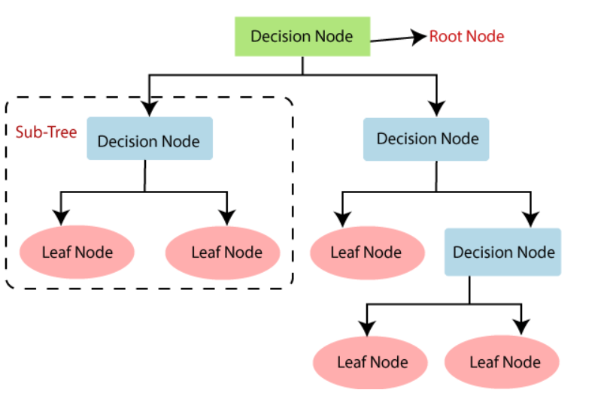
Decision Tree:
It is a tree-structured classifier, where internal nodes represent the features of a dataset, branches represent the decision rules and each leaf node represents the outcome.
A decision tree simply asks a question, and based on the answer (Yes/No), it further split the tree into subtrees.

Slide 22
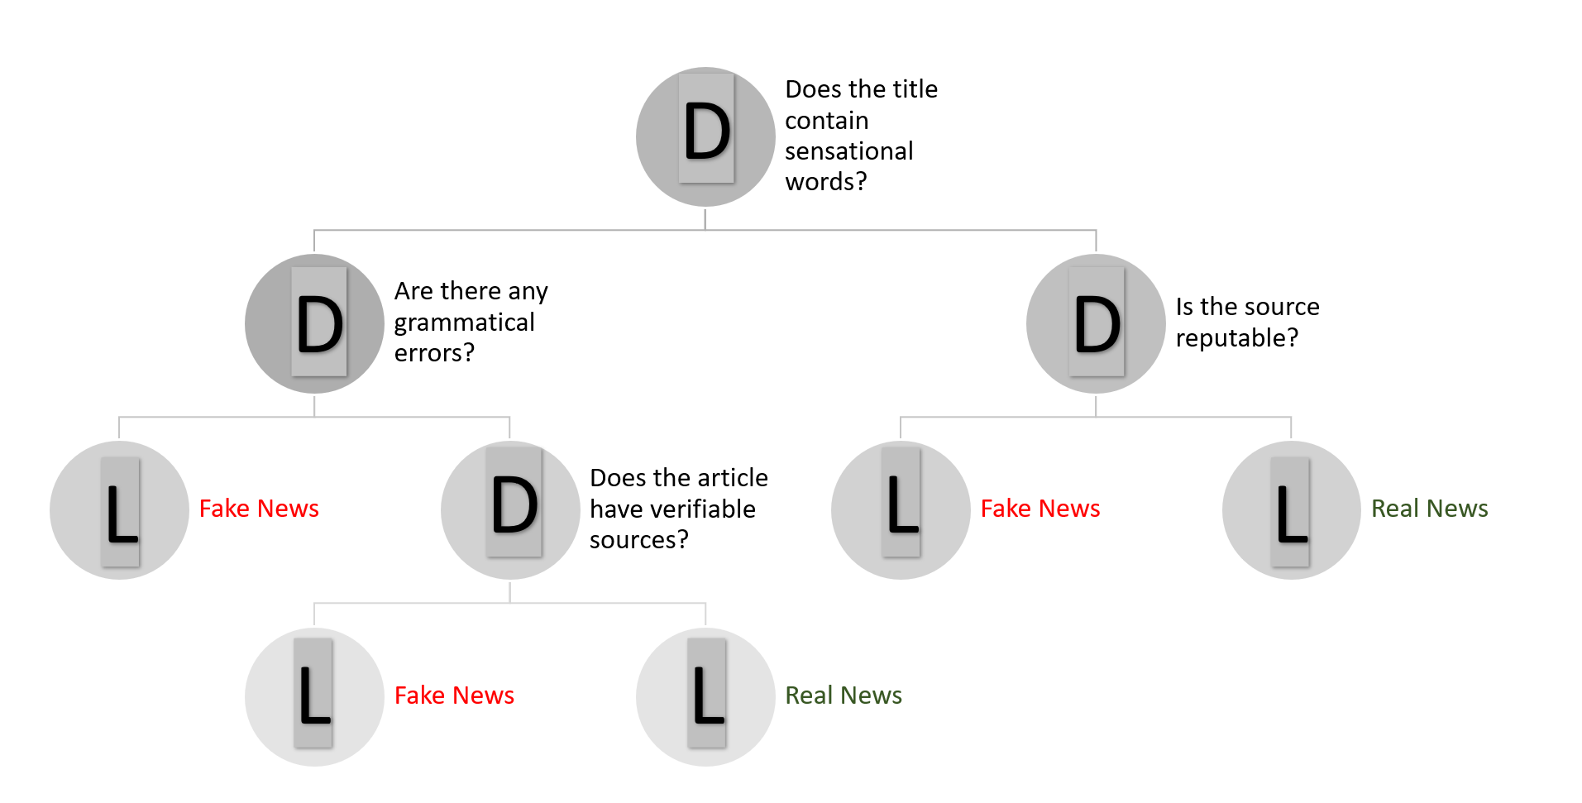
Example for Decision Tree in FND

Slide 23
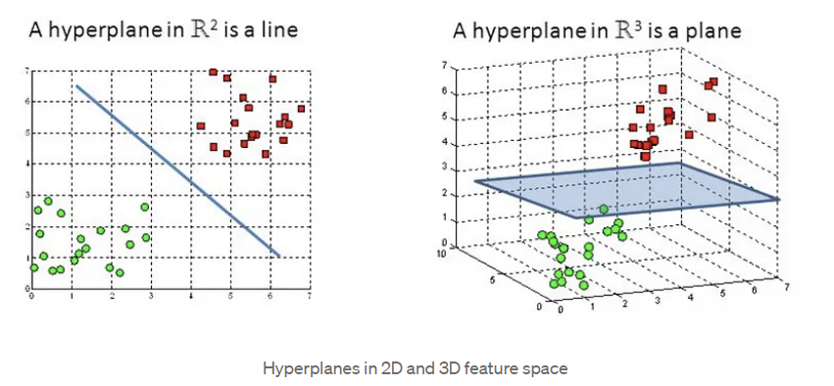
Support Vector Machine(SVM)
The objective of the support vector machine algorithm is to find a hyperplane in an N-dimensional space(N — the number of features) that distinctly classifies the data points.
To separate the two classes of data points, there are many possible hyperplanes that could be chosen. Our objective is to find a plane that has the maximum margin, i.e the maximum distance between data points of both classes. Maximizing the margin distance provides some reinforcement so that future data points can be classified with more confidence.

Slide 24
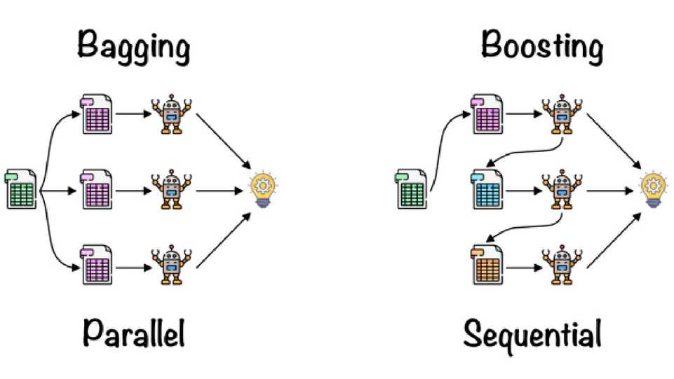
Random Forest Algorithm:
The algorithm’s strength lies in its ability to handle complex datasets and mitigate overfitting, making it a valuable tool for various predictive tasks in machine learning.
Ensemble Learning:
Ensemble simply means combining multiple models. Thus a collection of models is used to make predictions rather than an individual model.
Ensemble uses two types of methods:
Bagging
It creates a different training subset from sample training data with replacement & the final output is based on majority voting. For example, Random Forest.
Boosting
It combines weak learners into strong learners by creating sequential models such that the final model has the highest accuracy. For example, Gradient BOOST, ADA BOOST, XG BOOST.

Slide 25
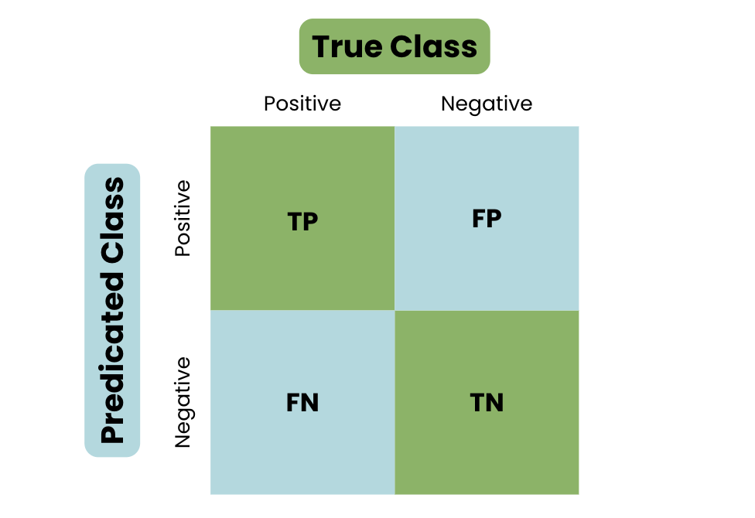
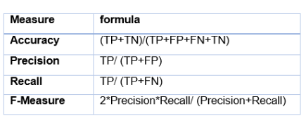
Confusion Matrix for the Test Data
In FND,
Positive: Fake News
Negative: Real News

Slide 26
Deep Learning Classifiers

Slide 27
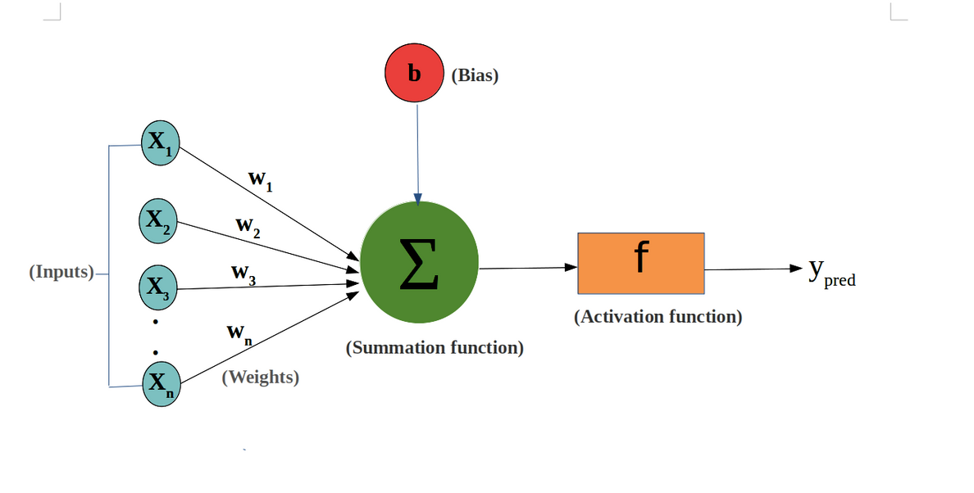

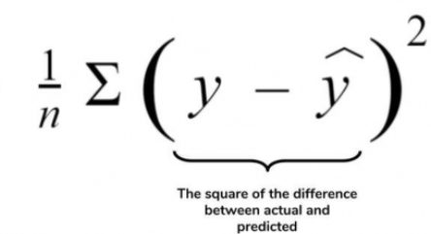
Artificial Neural Networks
Step 1: Chain rule
n
z = Σw(i)x(i)
i=1
Step 2: Activation Function
Sigmoid Function
y =
2. ReLu
y =max(0,z)
Step 3: Loss function

Slide 28
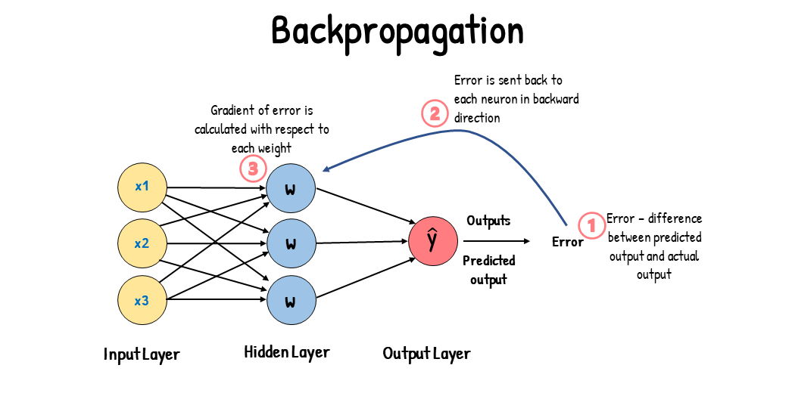
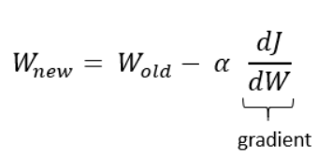
Loss function should be reduced.
Reduced using Optimizers
Step 4: BackPropagation(Updating weights)
L
L=Loss Fn.
α = Learning rate

Slide 29
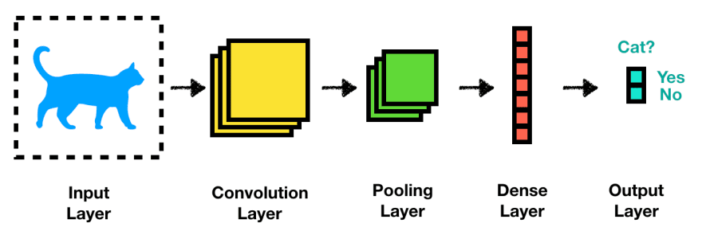
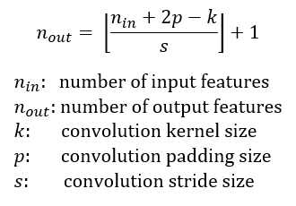
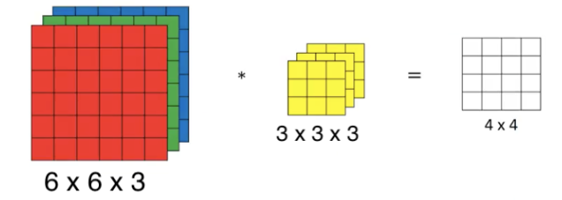
Convolutional Neural Networks
Mainly used for image detection
To process data that has grid like topology
Step 1: Convolution:

Slide 30
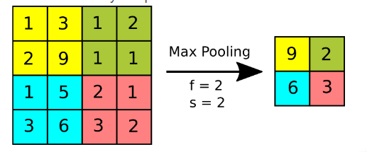
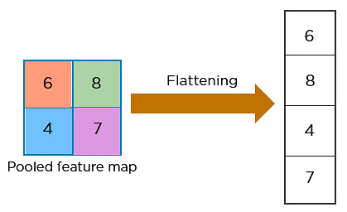
Step 2: Max-Pooling:
Max pooling is a pooling operation that selects the maximum element from the region of the feature map covered by the filter.
Step 3: Flattening Layer:
9
9
2
2
Intuition behind flattening layer is to converts data into 1-dimentional array for feeding next layer
6
3
6
3

Slide 31
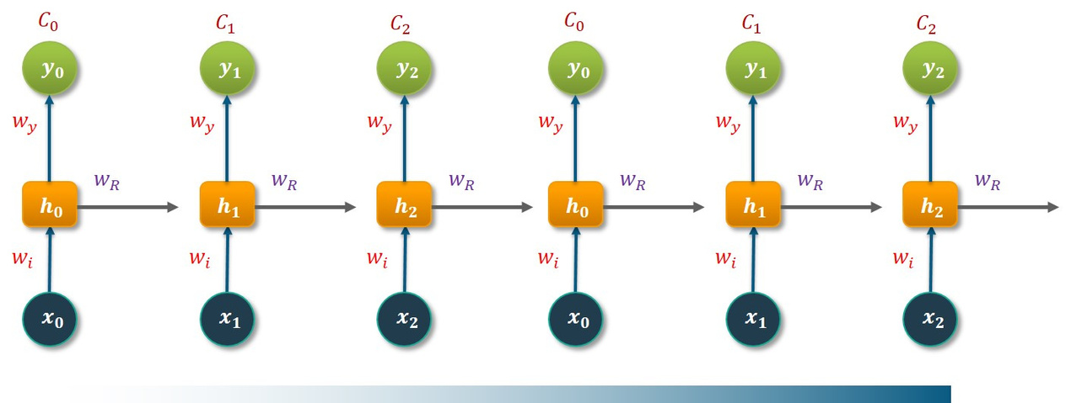
Recurrent Neural Networks
RNNs are a type of neural network that has hidden states and allows past outputs to be used as inputs.
The input layer X processes the initial input and passes it to the middle layer A. The middle layer consists of multiple hidden layers, each with its activation functions, weights, and biases.
Instead of using traditional backpropagation, recurrent neural networks use backpropagation through time (BPTT) algorithms to determine the gradient. In backpropagation, the model adjusts the parameter by calculating errors from the output to the input layer.

Slide 32
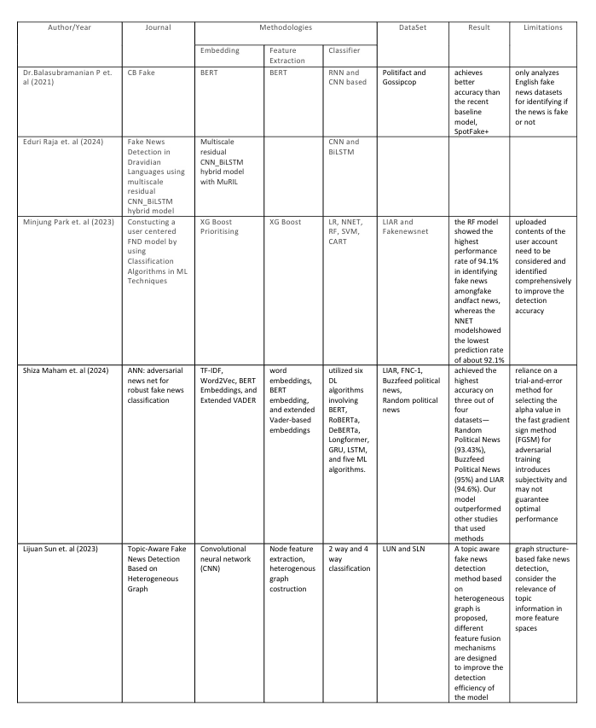
Literature Survey

Slide 34
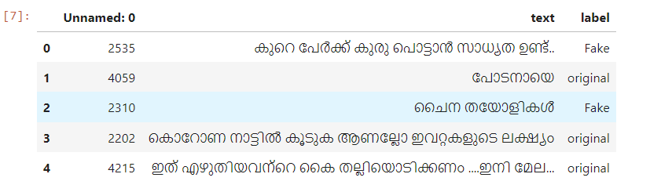
Data Set:
*offensive words are hidden in the dataset.
(815, 3)
Shape:

Slide 35
References:
https://nirajbhoi.medium.com/stemming-vs-lemmatization-in-nlp-efc280d4e845
https://www.javatpoint.com/machine-learning-decision-tree-classification-algorithm
https://towardsdatascience.com/the-heart-of-artificial-neural-networks-26627e8c03ba
https://medium.com/@muhammadshoaibali/flattening-cnn-layers-for-neural-network-694a232eda6a
https://www.datacamp.com/tutorial/tutorial-for-recurrent-neural-network
https://www.sciencedirect.com/journal/information-processing-and-management
https://www.sciencedirect.com/journal/expert-systems-with-applications

Slide 36
Thankyou

